Slide 1


Enhancing the Transit App
This presentation explores how to improve urban transportation information services. The goal is to enhance the user experience and provide more convenient and efficient travel options.
Team 2

Slide 2

Current App Limitations
Offline Access
Multimodal Transportation
Limited offline access means the app is useless during periods of unreliable connectivity, such as on trains or in underground stations.
The app lacks support for multimodal trips involving walking, cycling, or ride-sharing, limiting its usefulness for complex journeys.
Real-Time Crowd Information
Station and Stop Details
Insufficient station and stop details, like accessibility information, can be a major barrier for passengers with disabilities or special needs.
Absence of real-time crowd information makes it difficult for users to gauge wait times, leading to potential delays and frustration.

Slide 3



Research Methodology
Understanding the needs of our users was critical in designing this project. While we completed a comparative analysis, we recommend additional research methods to gather more comprehensive insights in future iterations.
Comparative Analysis
1
We studied similar transit apps and their features to identify strengths, weaknesses, and opportunities for improvement.
User Surveys
2
Conducting surveys would help gather feedback on the limitations and desired features of existing apps.
Focus Groups
3
Conducting surveys would help gather feedback on the limitations and desired features of existing apps.

Slide 4


Proposed Enhanced Features (Part 1)
Offline Accessibility
Multi-Modal Transport Integration
Downloadable route maps and schedules allow access to information even without internet connection. This is especially helpful for urban commuters who may experience intermittent connectivity on public transportation.
The app will offer a comprehensive trip planning experience by integrating multiple transportation options, such as buses, trains, shuttles, and rideshares. Users can compare different options to find the most convenient and cost-effective route.

Slide 5



Proposed Enhanced Features (Continued)
Real-Time Crowd Information
Detailed Station Information
The app will display real-time updates on vehicle occupancy. Users will be aware of crowding levels, allowing for better planning and avoiding discomfort.
The app will provide comprehensive amenities information, accessibility features, and real-time service updates. Users can make informed decisions and plan their trips with ease.

Slide 6
Key Innovative Additions
Personalization and Community
Accessibility Focus
The app will offer customizable notifications, integrating local event information.
The app prioritizes accessibility with detailed information for users with disabilities.
Users can earn points through a gamified reward system and participate in a community support forum.
It will be designed with inclusive principles, ensuring an enjoyable and user-friendly experience for all.

Slide 7
Technical Implementation Timeline
Week 1
1
Gather user feedback and insights to understand current needs and pain points.
2
Week 2
Prioritize the proposed features based on their impact and feasibility.
Week 3
3
Begin development of the core features, ensuring a robust and user-friendly design.
4
Week 4
Conduct thorough usability testing to identify and address potential issues.
Week 5
5
Refine the application based on testing feedback and make necessary adjustments.
6
Week 6
Launch the enhanced transit app and promote it to the University of Maryland community.

Slide 8




Expected Impact
Enhanced User Experience
Users will navigate transit systems more efficiently. The app will be easier to use and more informative.
Increased Ridership
The app will provide a convenient and efficient way for commuters to access transportation options. More people will use public transportation.
Urban Mobility
Improving public transportation access can help reduce traffic congestion and improve air quality.

Slide 9
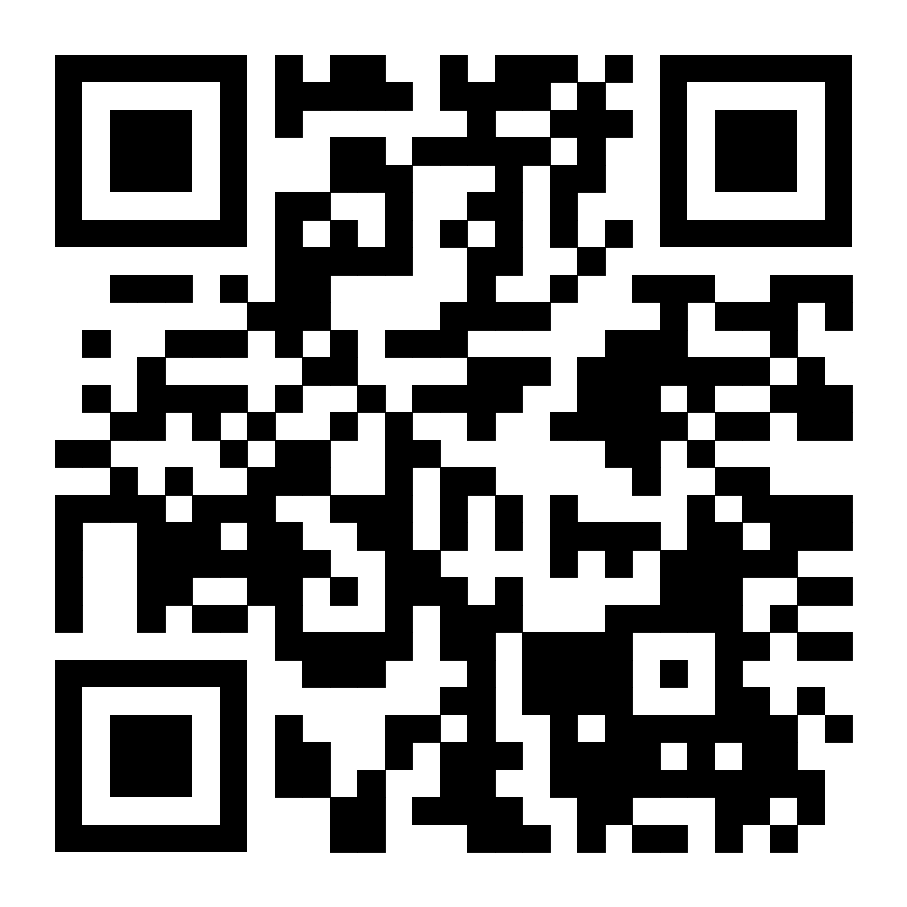

Project Repository
Open Source Collaboration
Access project materials on GitHub. Scan the QR code on the right to access our repository.

Slide 10

Questions?
We welcome your questions and feedback.
Contact our team to learn more about our project, collaborate, or provide valuable input.
Transforming urban transportation, one app at a time.

